Slide 1

Dr. Fraud
Discovering fraudsters among doctors
Notes:
Intro (Data-Scientist)
last two weeks
analyzing drug prescription records from Medicare
Machine Learning model to
detect potential prescription fraud.
next few slides - my findings
but before I begin, let me go over some numbers

Slide 2
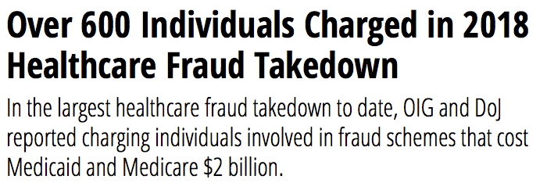
Notes:
the Institute of Medicine estimates fraud at ~ $750B+ per year
US General Attorney Office reports improper payment rate of 10%.
Just a few weeks ago, this hit the news - the largest Healthcare Fraud takedown to date amounting to $2B

Slide 3
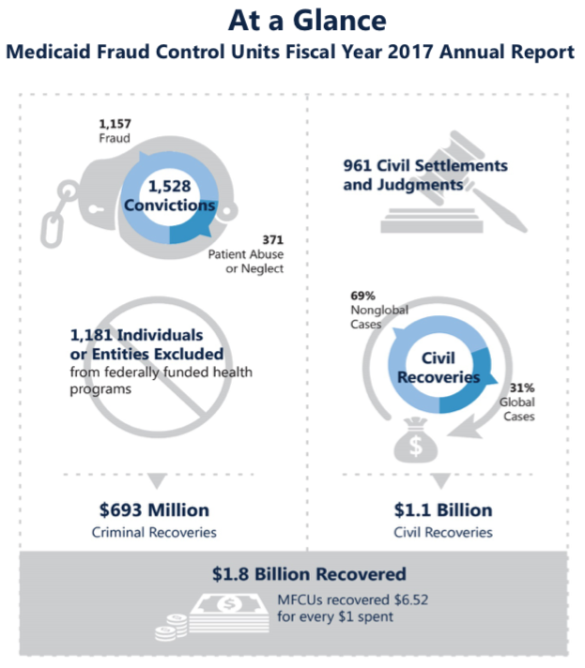
Notes:
- investigation starts with the complaint filed with the Federal Communication Commission
- This process is slow and labor intensive but non-the less very effective.
- Propose passive methods using ML/AI to help narrow down on targeting these investigations.

Slide 4







Data Sources

Slide 5
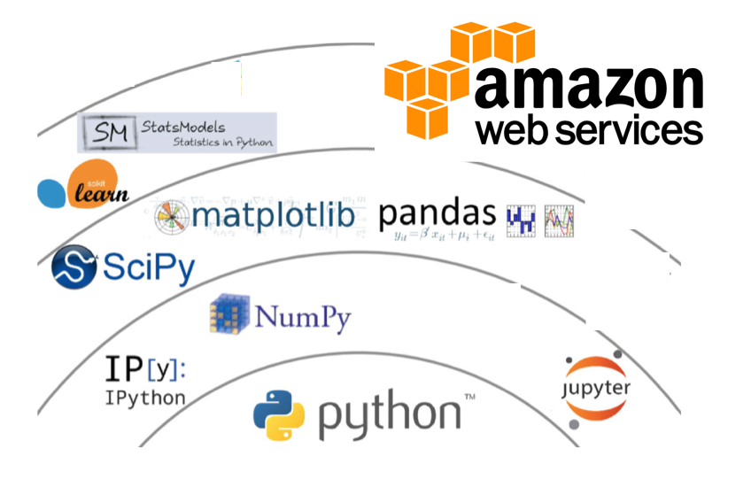
Tech Stack
Notes:
large dataset for my local machine
so I used a very powerful AWS cloud infrastructure &
standard python based data-science tech stack.

Slide 6
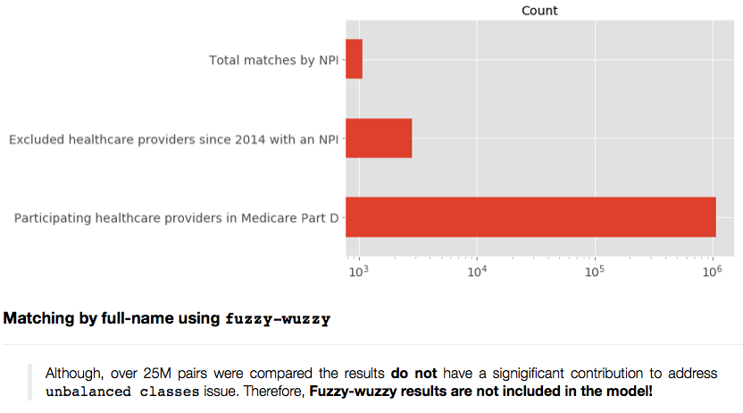
Preserving the Signal
Number of Records
1,079
2,843
1,075,934
Notes:
Common ‘class imbalance’ issue in fraud and disease diagnosis
To preserve as much as possible of this signal, I used some sophisticated techniques to oversample the minority target class, including :
Random Bootstrap sampling, and
SMOTE

Slide 7
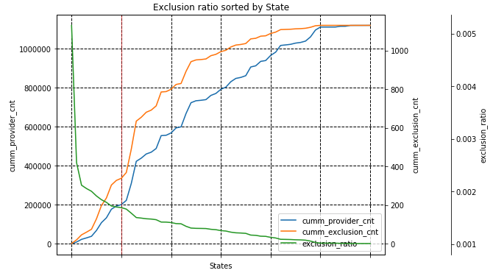
Top 10 States by Exclusion Ratio:
Notes:
Additionally, I looked into the dynamics of the number of exclusions relative to the total number of Medicare providers by State.
In West Virginia, drugs are killings so many people that the State can’t keep up with the funerals

Slide 8
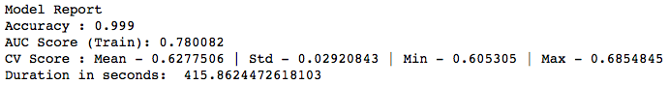
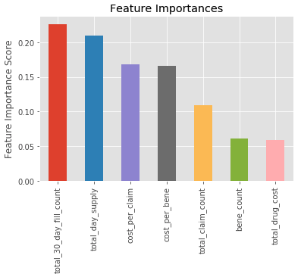
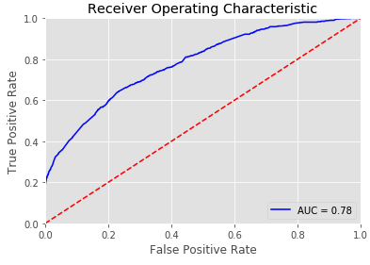
Notes:
- ROC curve is a measure of trade-of between correctly identifying the true signal relative to incorrectly identifying false signals as we increase the acceptance threshold.
- Started with: Random forest had an AUC of .72 and CV score of .62.
- Landed on Gradient Bosting with the AUC score of .78 and CV score of .63.
I expect the model performance to improve through some hyper-parameter tunining
The model picked up on these 2 top features:
30-day fill count
total day supply

Slide 9
Next Steps
Notes:
In conclusion, Medicare - an age-based, federal health insurance program that guarantees coverage for individuals aged 65 and over doesn’t seem to have any reliable predictors to detect a potential healthcare fraud!
However, the loss of human life and the amount of money healthcare fraud costs the American tax payers warrants further investigation by incorporating other data sources.

Slide 10
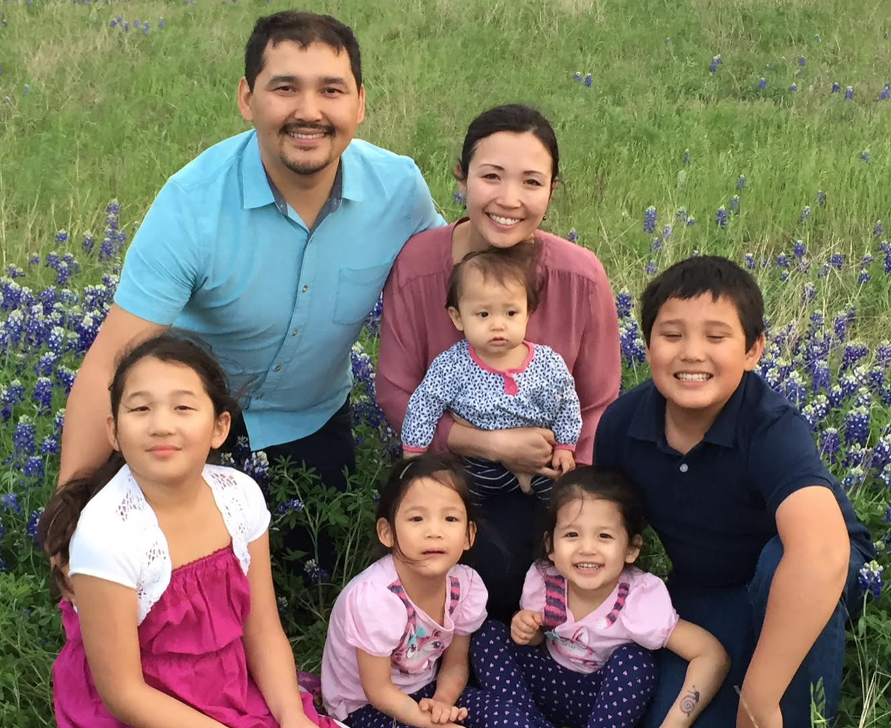



linkedin.com/in/dastan1/
github.com/dast1
dastan.aitzhanov@gmail.com
Notes:
If you’re interested to look into more details, feel free to look into my GitHub.
Thank you!

